Slide 1
TIC TAC TOE
C . SARADA
192011042

Slide 2
PROJECT INCLUDES
Abstract
Objectives and introduction
Proposed work
Test cases
Apps and tools in installation
Appium server
Implementation and testing
Test case outcomes
Conclusion

Slide 3
ABSTRACT
Tic-Tac-Toe is a fun game played by two players .
Before starting the game , 3x3 square grid formed using two vertical and two horizontal lines.
The player who succeeds in placing three of their marks in a horizontal, vertical, or diagonal row is the winner.
The purpose of the paper is to transport this commonly traditional game to modern electronic game .

Slide 4
INTRODUCTION
Traditional games are educational tools used in running process of an individual ,particularly children.
Games teach and urge children to use indirect ways of cooperative thinking and creative thinking.
It also specifies the right of the children to the enjoyment of the highest attainable standard of health and to facilitate for the treatment of illness and rehabilitation of health.
Games are important for children as they increase harmony between mind and muscles.

Slide 5
OBJECTIVES
The game is very popular and is fairly simple by itself .
It is actually two player game .
In this game there is a board with nxn squares.
The goal of Tic-Tac-Toe is to the one of the players to get three same symbols in a row- horizontally , vertically or diagonally – on a 3x3 grid.

Slide 6
PROPOSED WORK
The players need to position their marks .
So that they make a continuous lines of three cells vertically, horizontally ,diagonally.
An opponent can prevent a win by blocking the completion of opponents line .
By blocking the opponents line he/she can win the game

Slide 7
TEST CASES
App lunch
Performance
User convenience
Game starting
keyboard working
Score appearance.

Slide 8
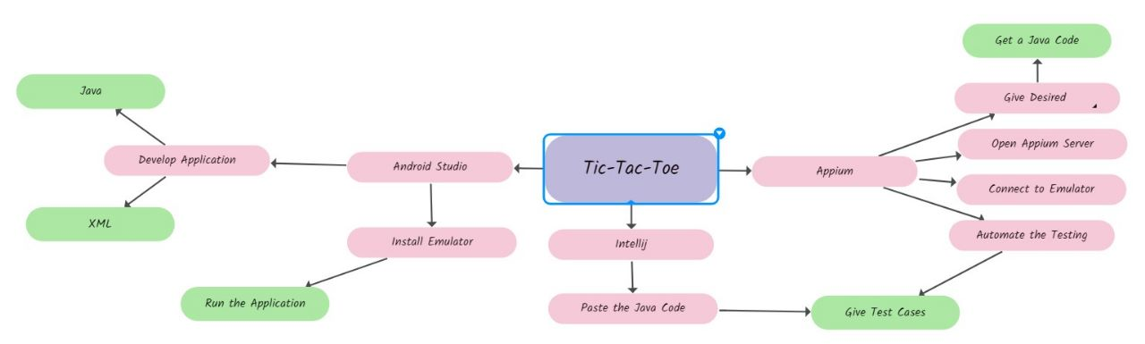
CONCEPT MAP

Slide 9

APPLICATIONS USED

Slide 10
APPS AND TOOLS(APPIUM AND ANDROID STUDIO)
It is integrated development environment.
It has fast emulator for app testing.
It is used to develop applications for android devices.
It automates any mobile applications from any language.
It is a open source software.

Slide 11
TEST CASE OUTCOMES
App lunch (positive)
Performance(positive)
User convenience(positive)
Game starting(positive)
Keyboard(positive)
Score appearance(positive)

Slide 12
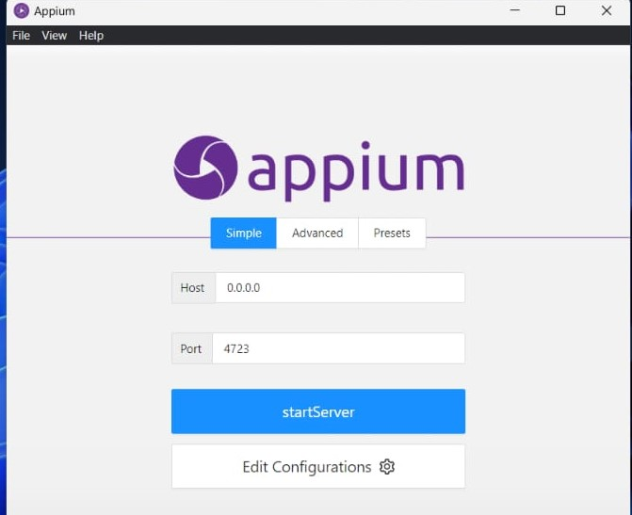
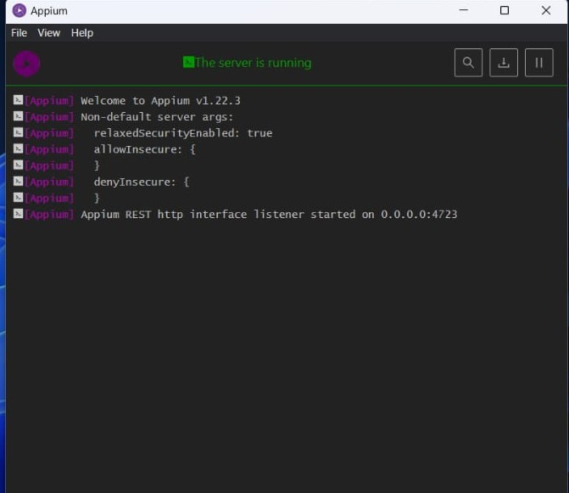
APPIUM SERVER
BEFORE STARTING SERVER
AFTER STARTING SERVER

Slide 13
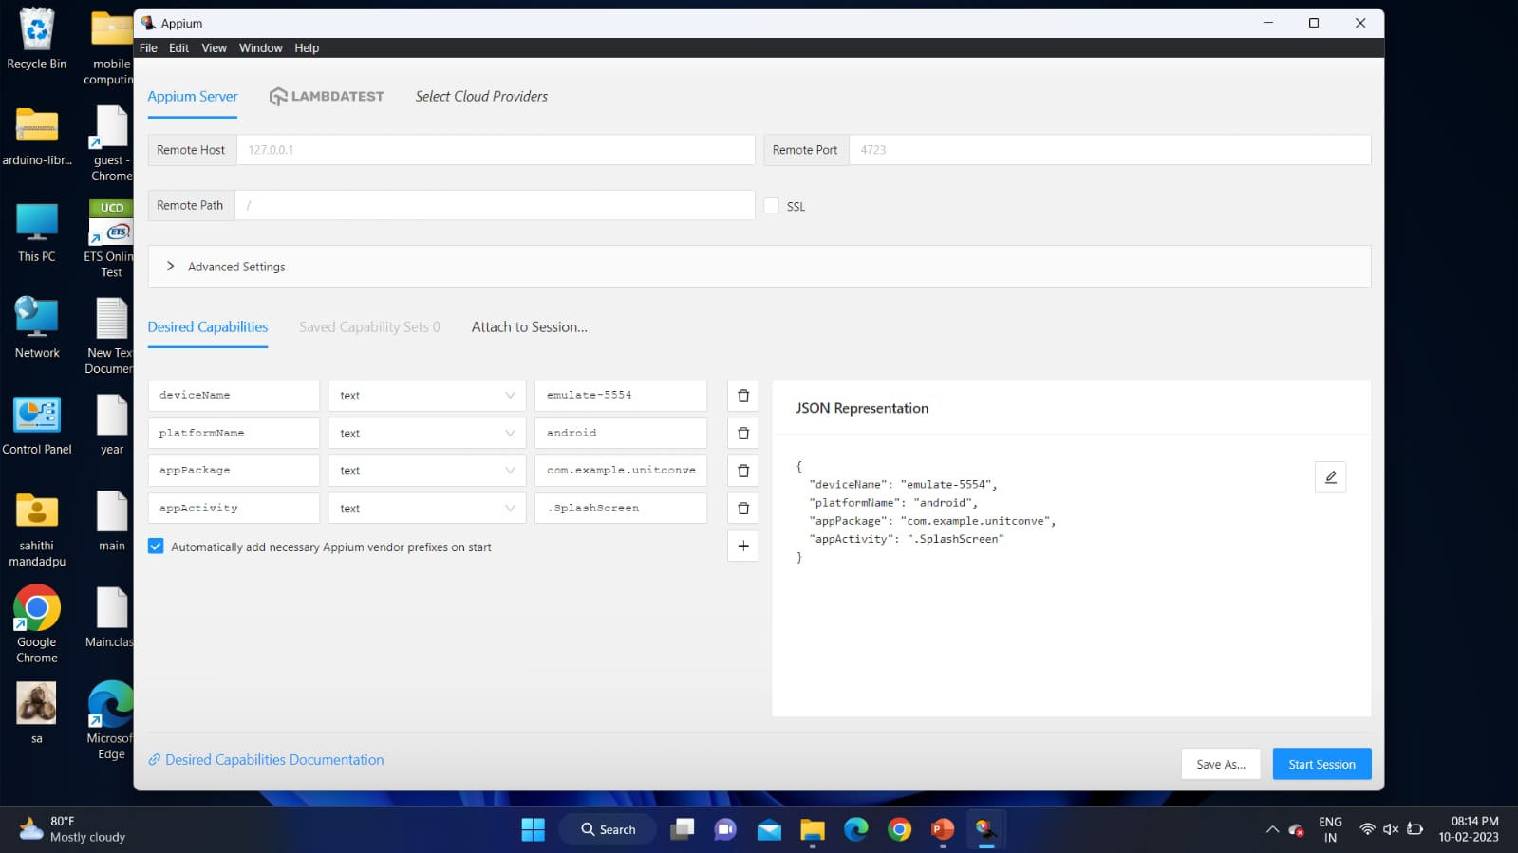
APPIUM INSPECTOR(DESIRED CAPABILITIES)
Give the desired capabilities in Appium inspector.
It will start the session and gives you java code to start testing.
Paste the code in IntelliJ IDE and start the testing.

Slide 14
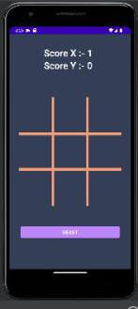
IMPLEMENTATION AND TESTING

Slide 15
CONCLUSION
Hence we concluded that this game provides mental strength for children .
The Tic-Tac-Toe is a great way to pass your free time whether you are standing in a line or spending time with your kids.
By this we can learn how to develop strategies to help you pull through.
These kinds of life lessons that you would want to share to your children.

Slide 16
Thank you

